Slide 1
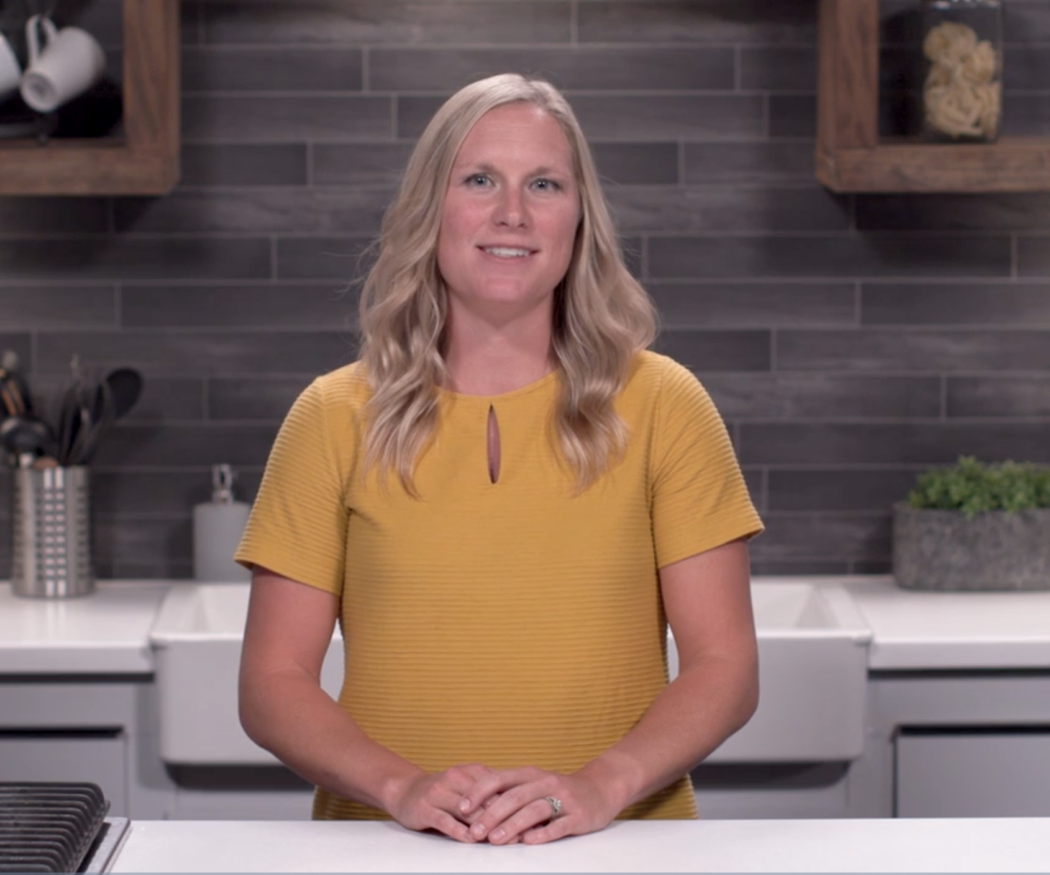
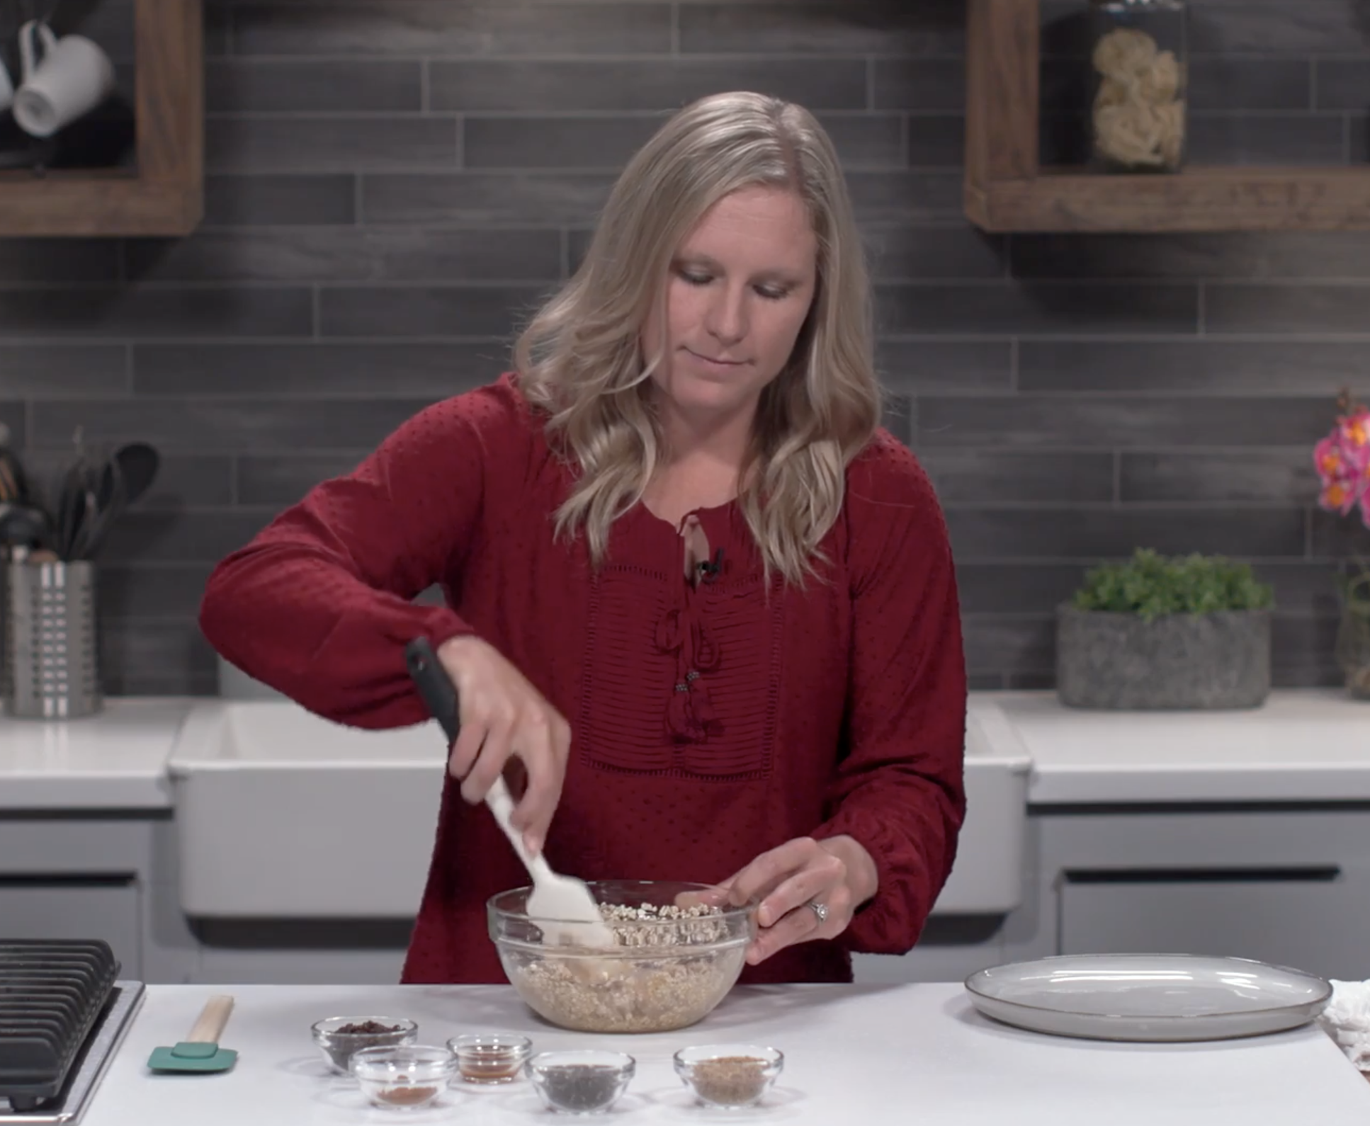
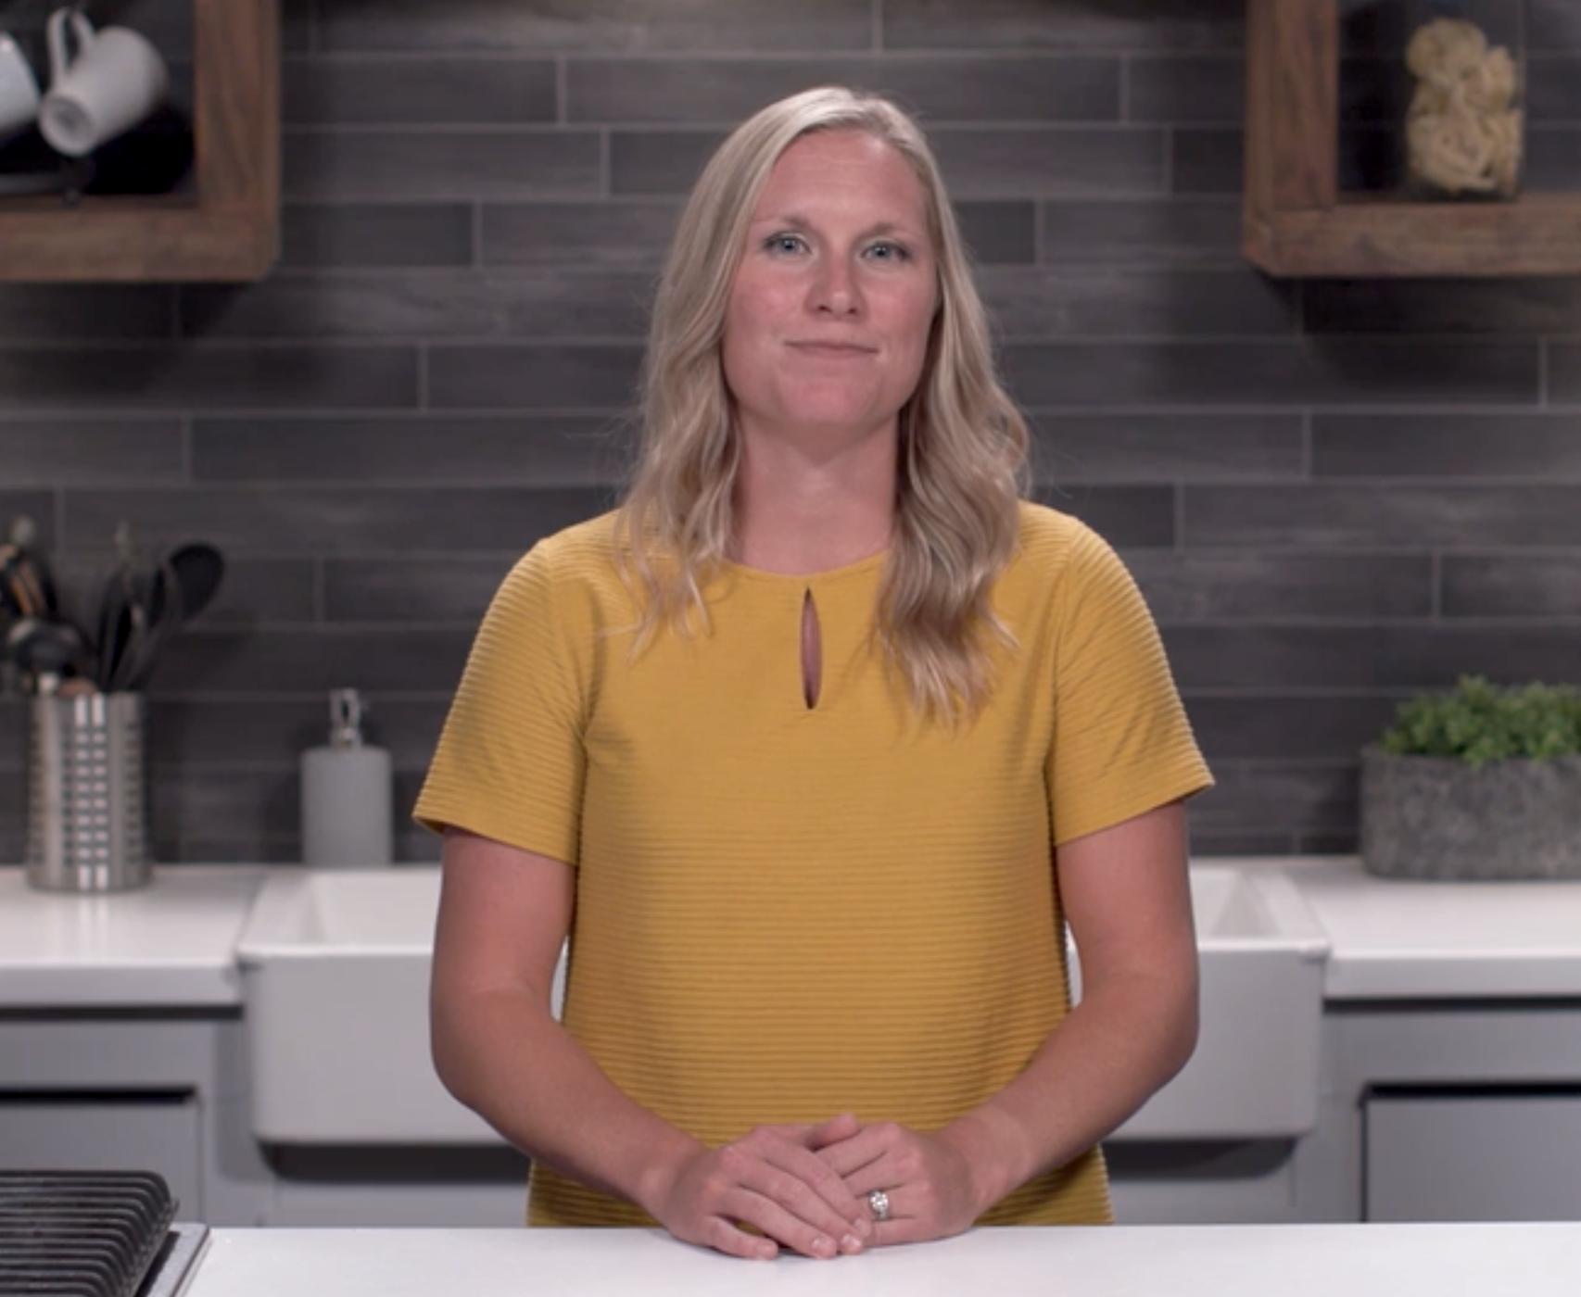
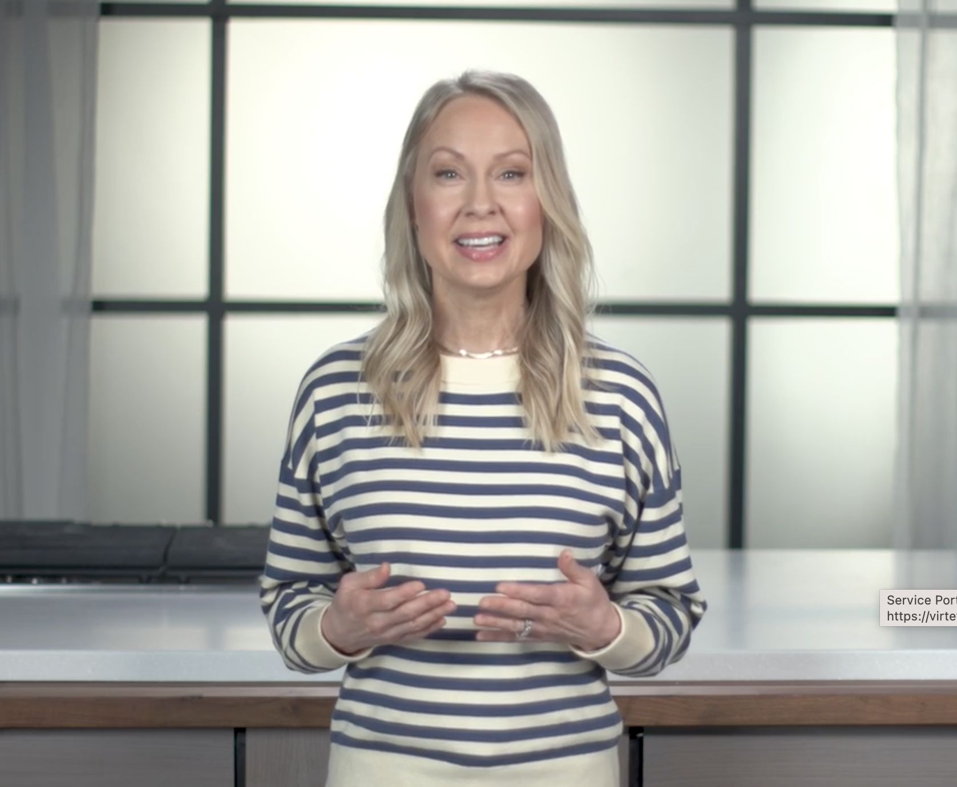
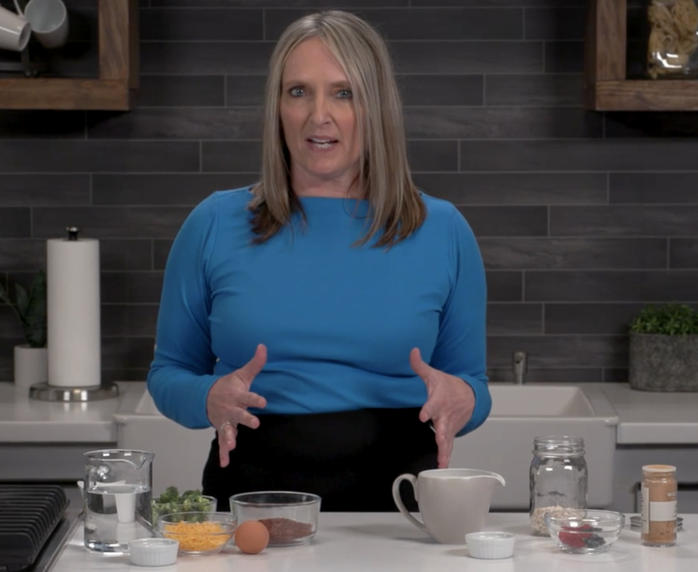
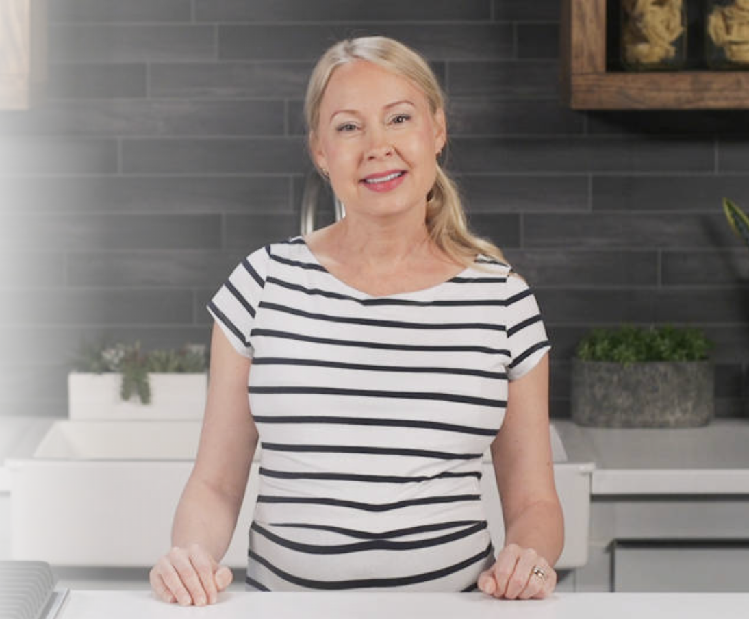
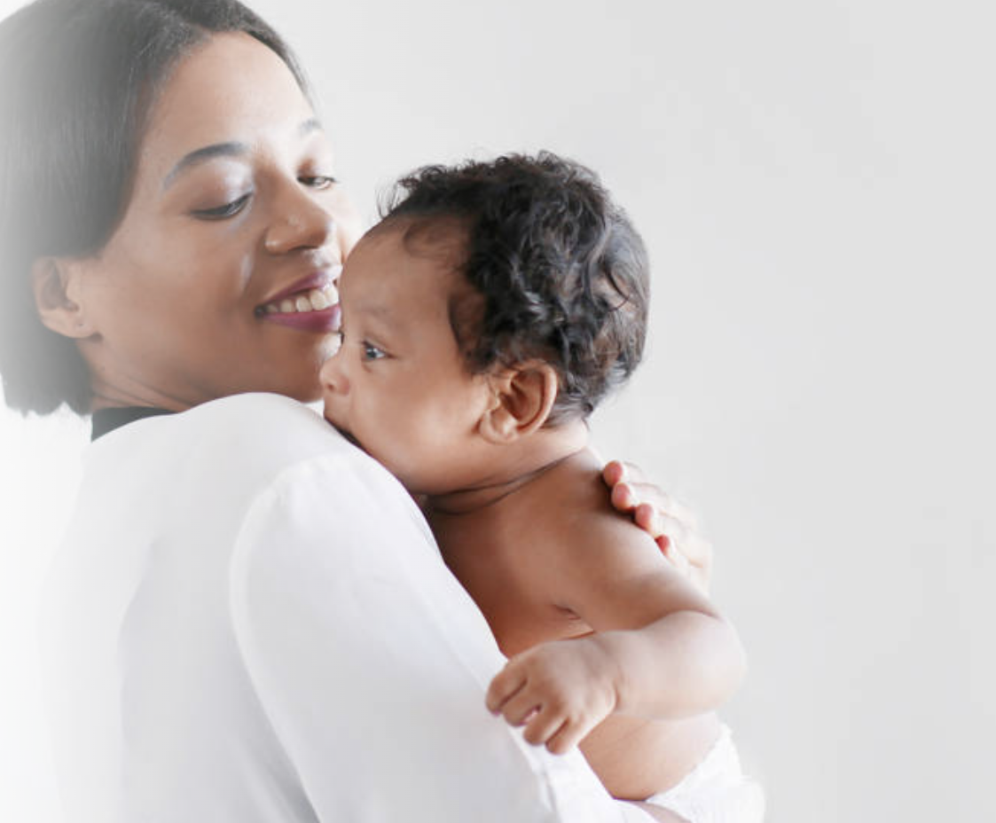
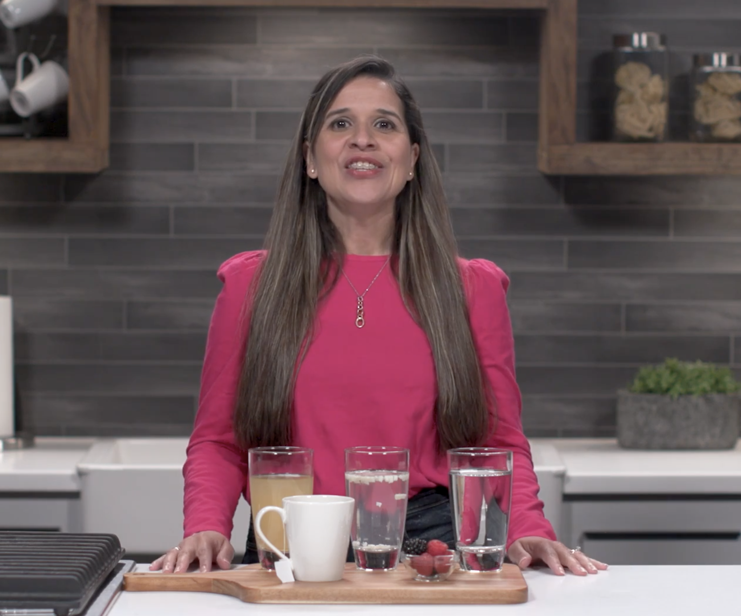
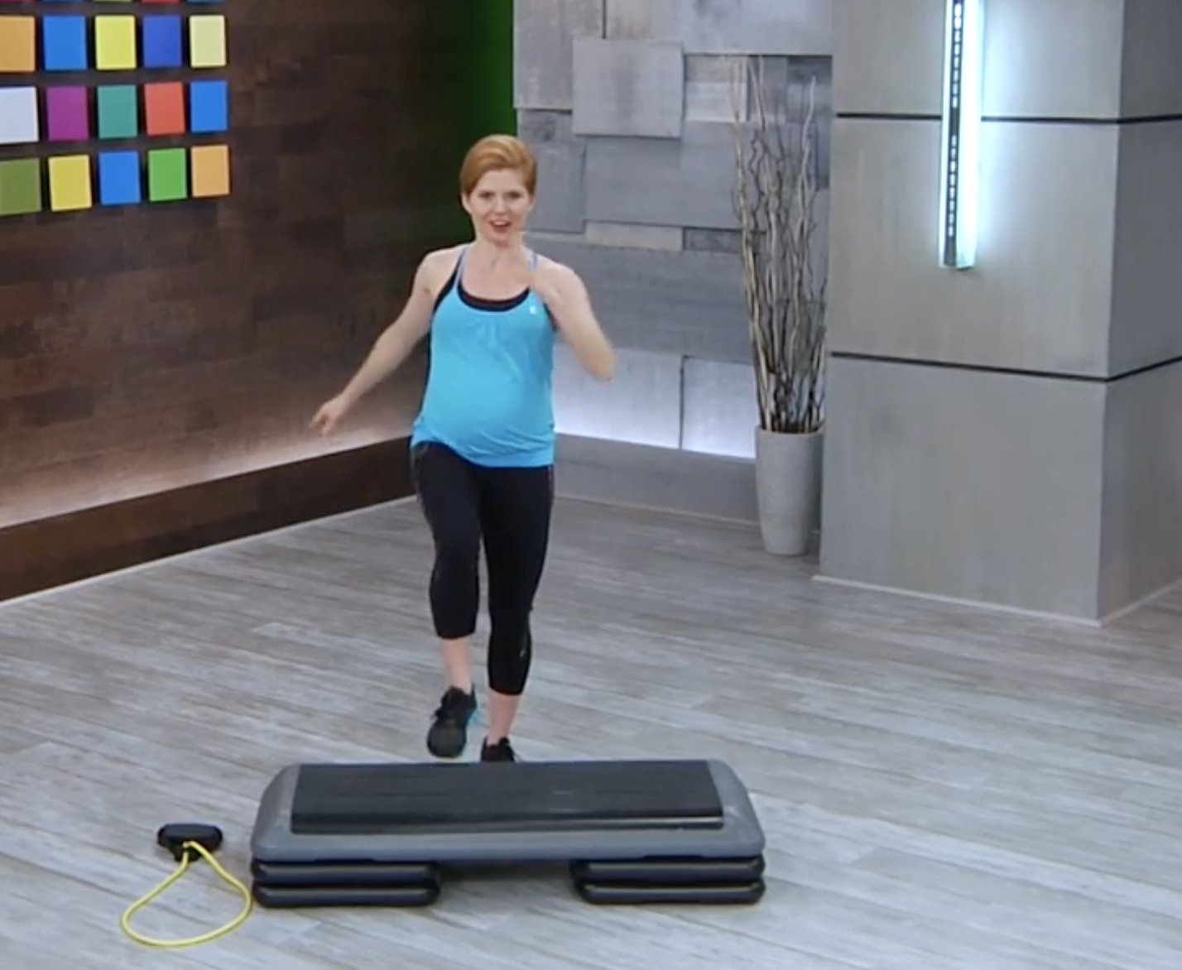
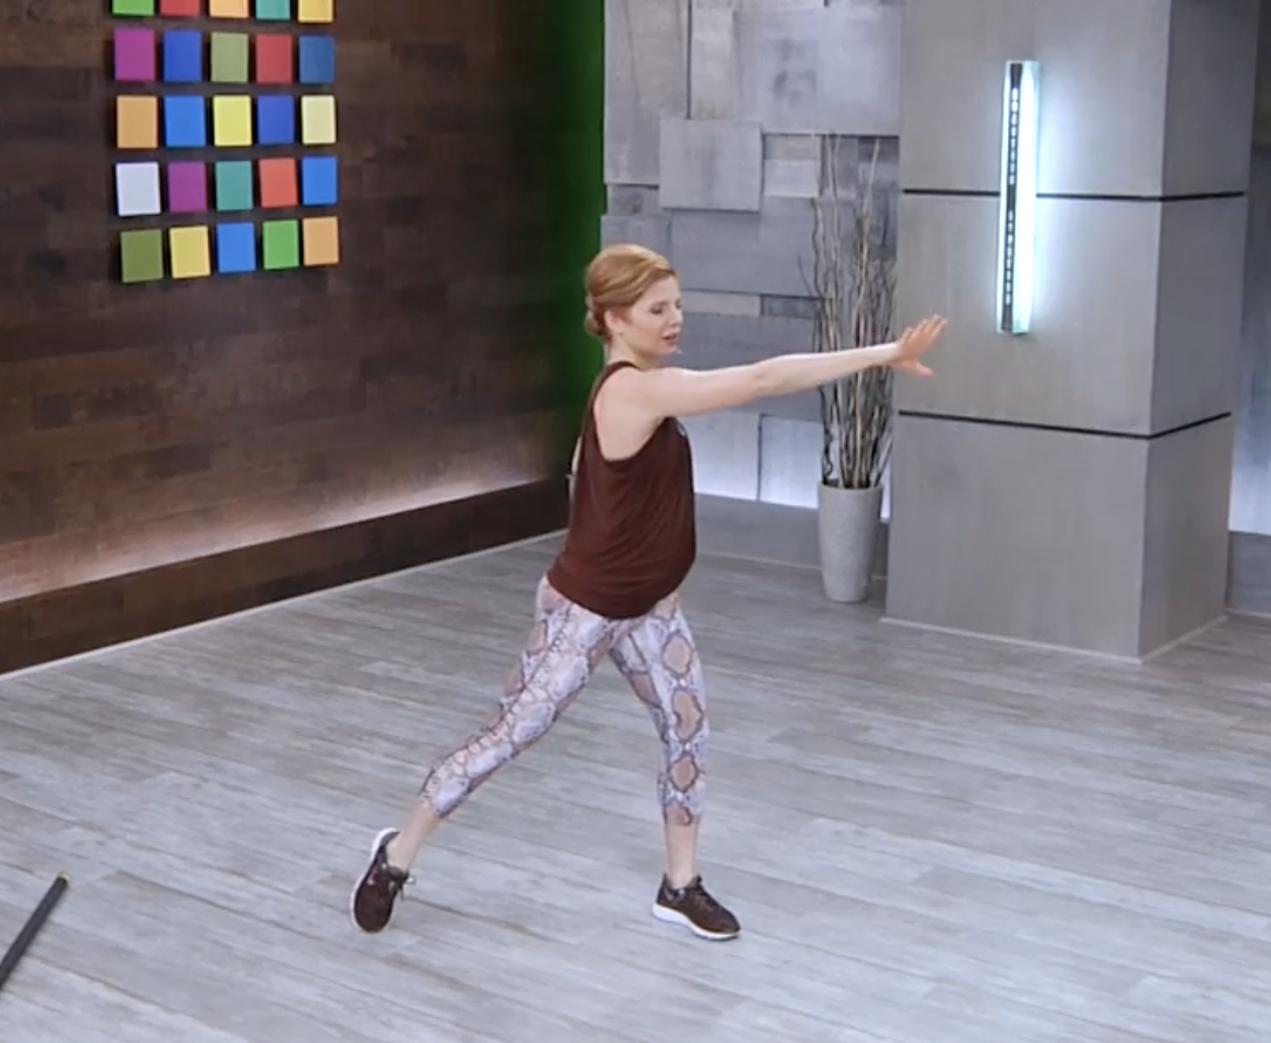
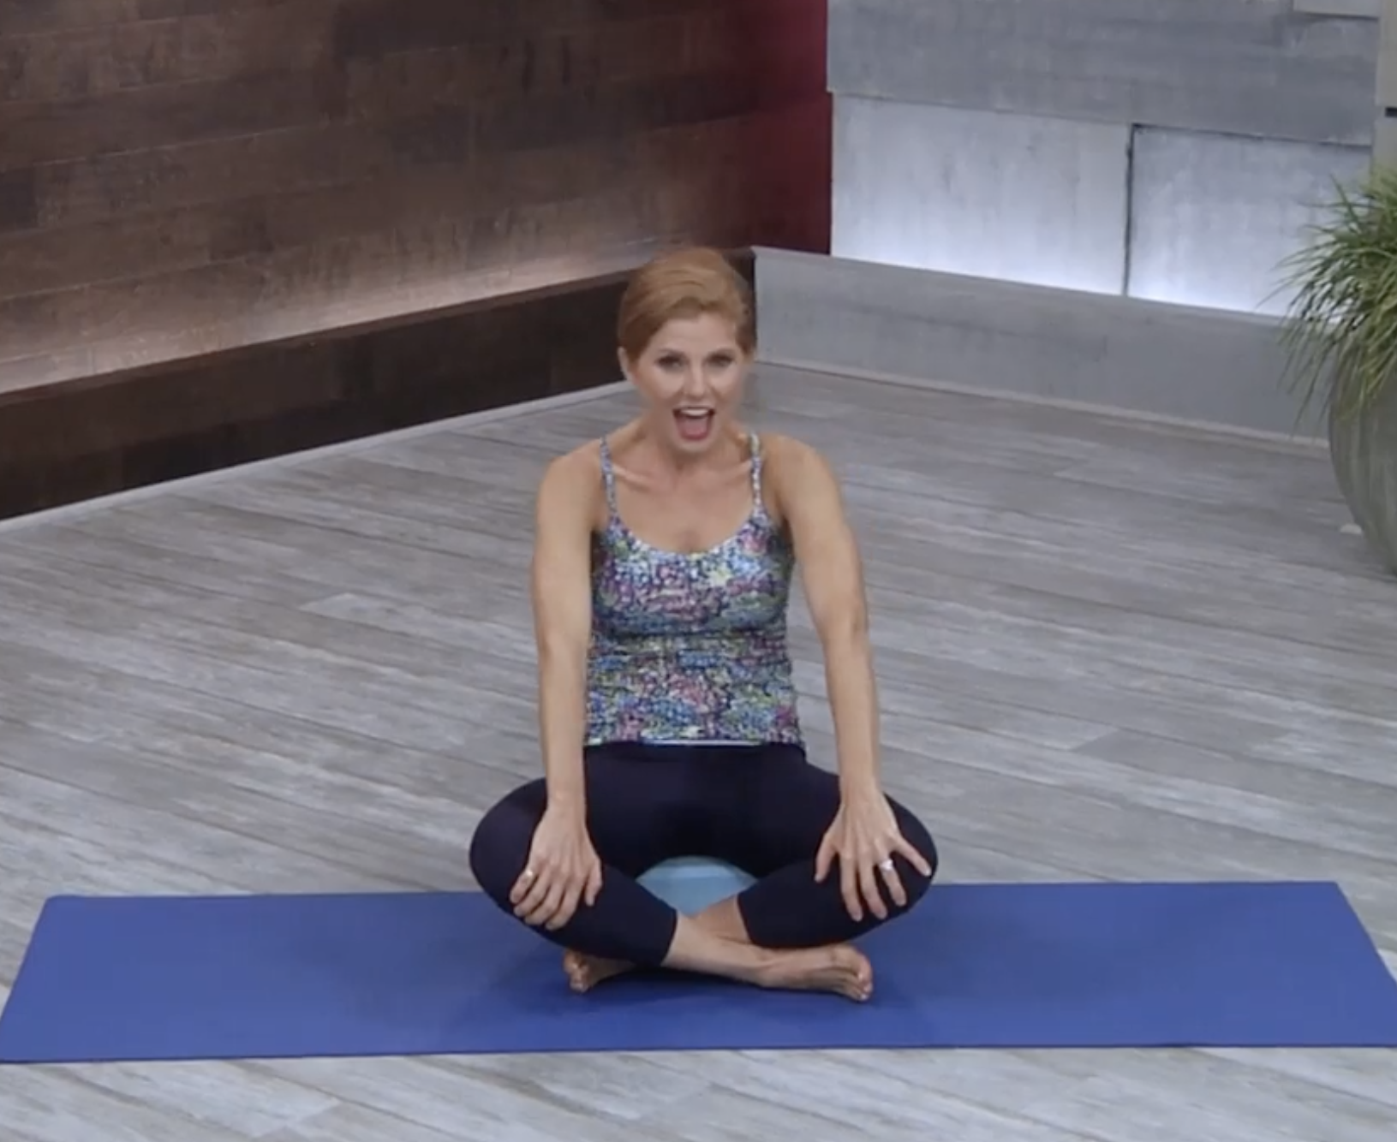
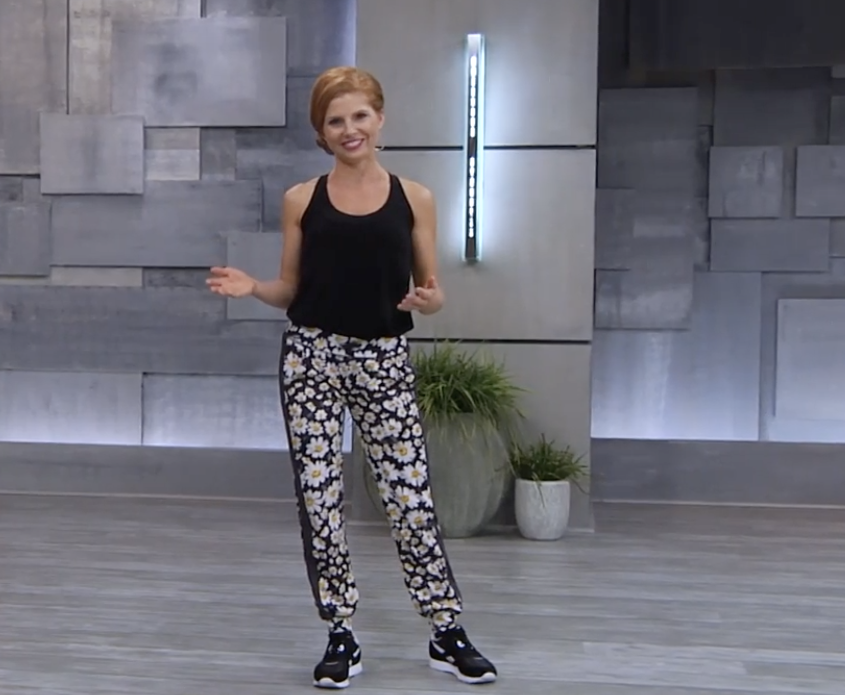
WOMEN’S NUTRITION | Classes
Program
Women’s Health Content Library
Nourished Mom
Energy Bites for New Moms
Pregnancy Plate
Nutrition After 50
Women’s Hormones 41 Activities | 6 Weeks
PRE & POST-NATAL NUTRITION | Classes
Program
Access robust content across a range of topics that supports every stage of women’s health.
Explore the complete catalog on Wellbeats.
Pre-Natal Nutrition 1st Trimester
Pre-Natal Nutrition 2nd Trimester
Pre-Natal Nutrition 3rd Trimester
Pre-Natal Nutrition 4th Trimester
Prenatal Nutrition 19 Activities | 4 Weeks
PRE & POST NATAL FITNESS | Classes
Pre-Natal: Strong Mama
Pre-Natal: Stretch & Release
Post-Natal: Core Rebuild
Post-Natal: Muscle Conditioning
Post-Natal: Cardio Blast
Notes:
Women’s health is dynamic, evolving and deeply personal. It isn’t one-size-fits-all, that’s why our classes and programs are thoughtfully designed to meet you where you are. Whether you’re embracing change, navigating new challenges, or simply looking to feel your best, our holistic approach and expert guidance are here to support you. Wherever you are in your journey, we’re here to walk alongside you. Looking for the different ways Wellbeats Wellness support women’s health? We have curated women specific classes and programs with you in mind. Ready to start?

Slide 2
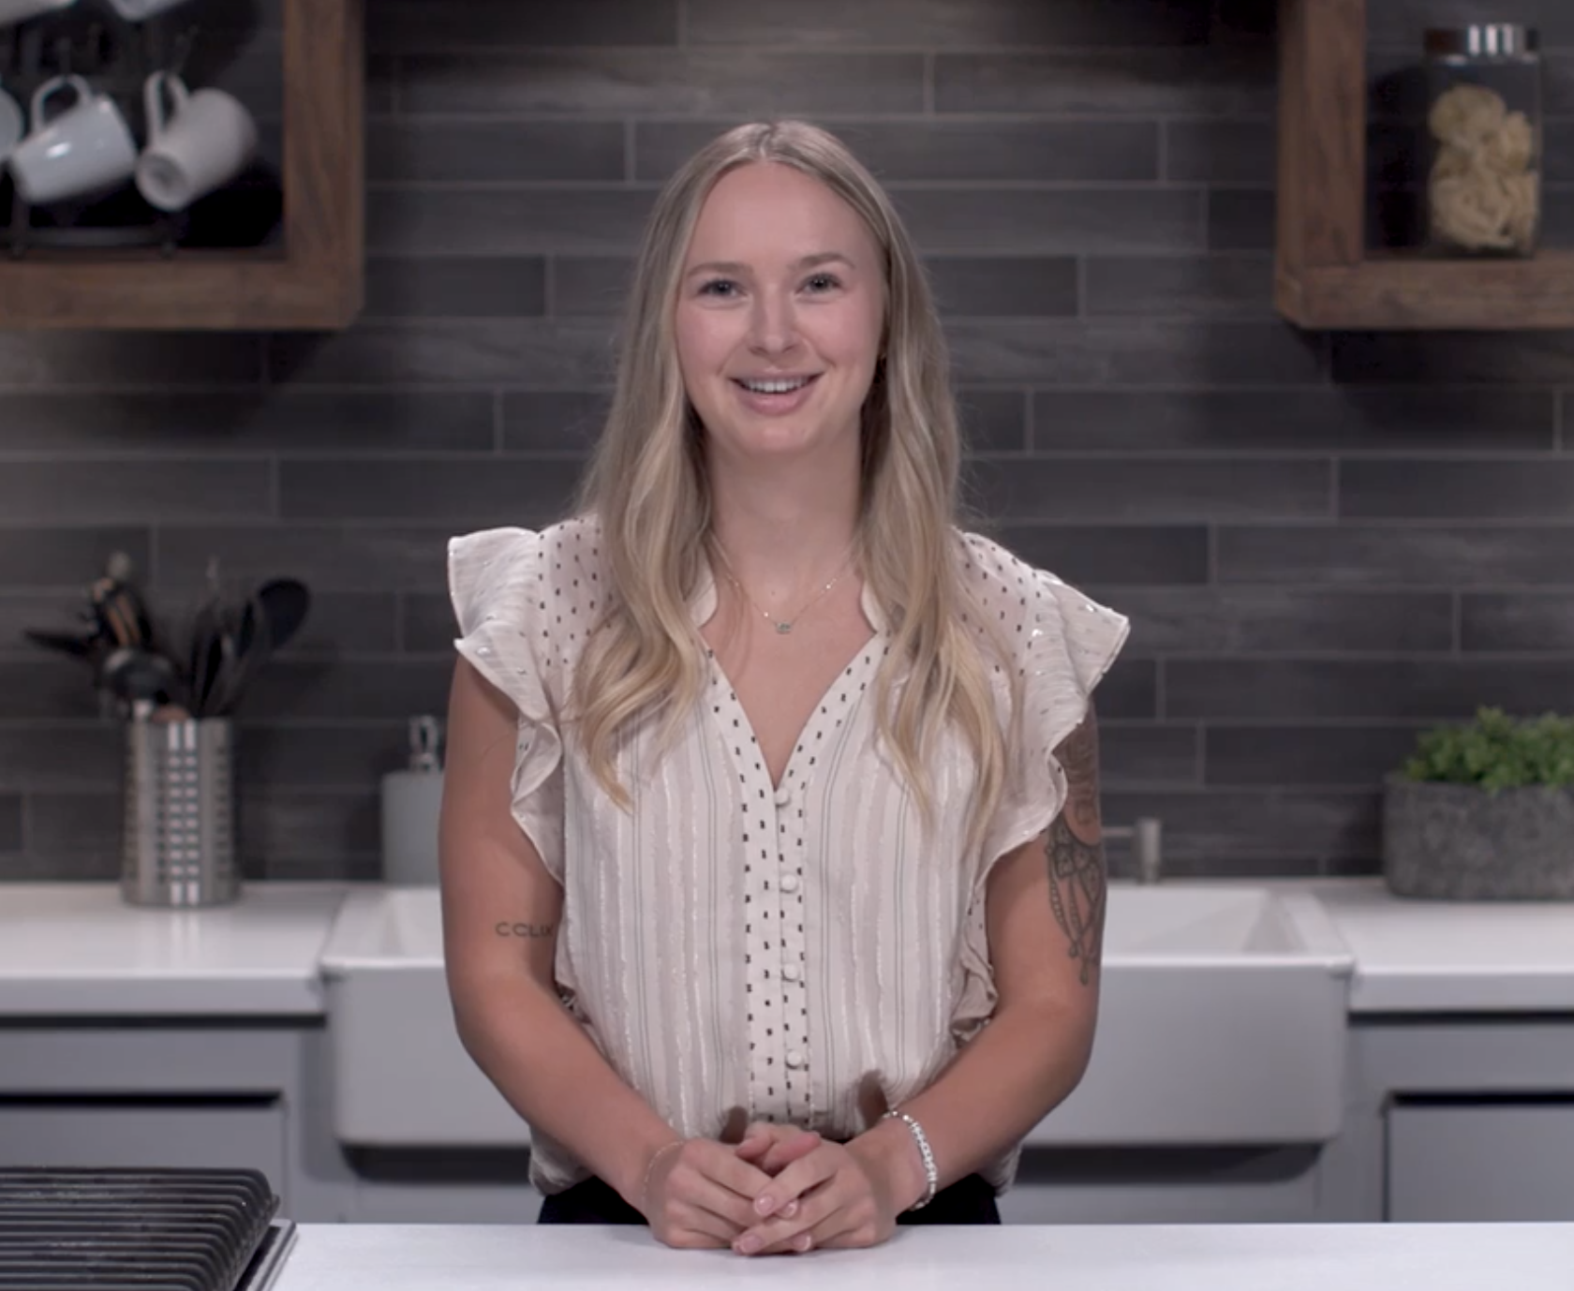
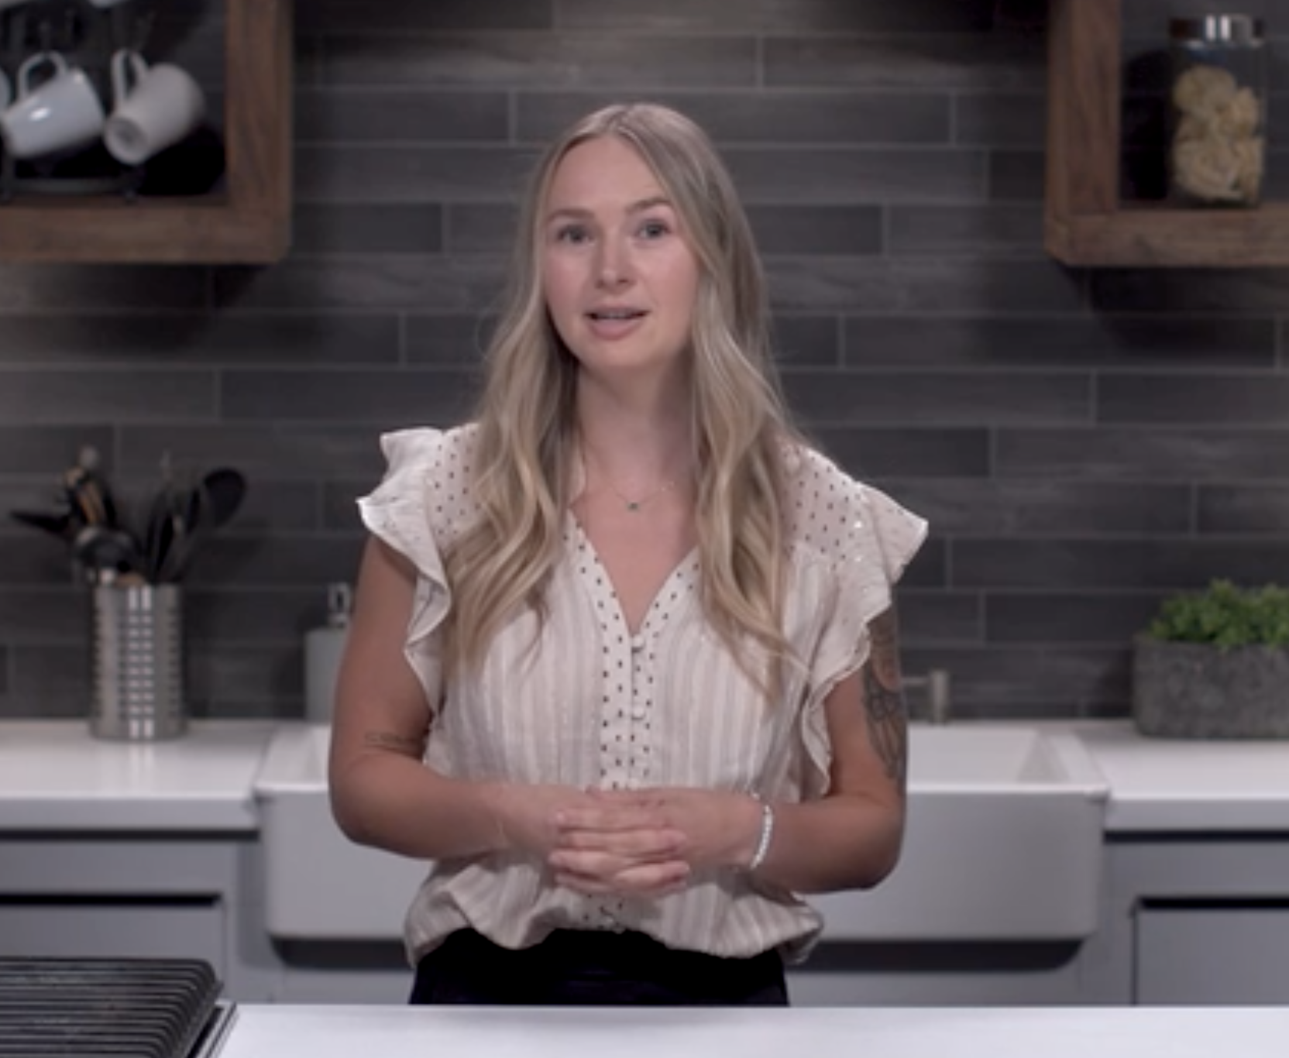
PCOS Classes
Women’s Health Content Library
Understanding PCOS
Navigating PCOS
NEW! WOMEN’S HORMONES & FITNESS
Access robust content across a range of topics that supports every stage of women’s health.
Explore the complete catalog on Wellbeats.
PERI POWER 14 Activities | 2 weeks
Work with your hormones while supporting your strength, flexibility, and energy during perimenopause.
PRIME POWER 14 Activities | 2 weeks
Improve strength, mobility and endurance to work with what your body needs during post menopause.
Notes:
Women’s health is dynamic, evolving and deeply personal. It isn’t one-size-fits-all, that’s why our classes and programs are thoughtfully designed to meet you where you are. Whether you’re embracing change, navigating new challenges, or simply looking to feel your best, our holistic approach and expert guidance are here to support you. Wherever you are in your journey, we’re here to walk alongside you. Looking for the different ways Wellbeats Wellness support women’s health? We have curated women specific classes and programs with you in mind. Ready to start?

