Slide 1
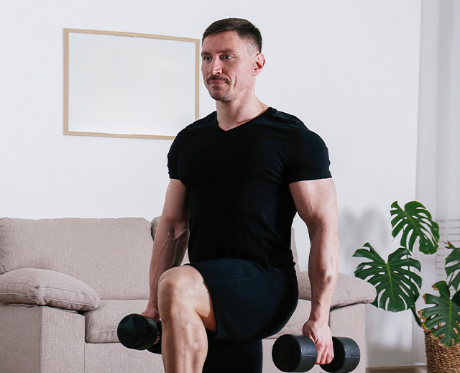
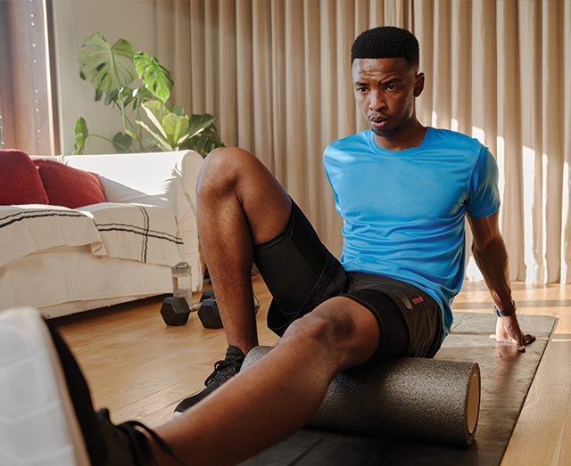
PROGRAMS
Empowering Men’s Health
Wellness is for everyone at Wellbeats. We offer diverse content to empower every health and wellbeing journey. Discover popular programs for strength, flexibility, stress management, or relaxation that many men find effective and inspiring.
Get Stronger 8 Activities | 2 Weeks
Game on: Golf 18 Activities | 3 Weeks
Athletic Performance 21 Activities | 3 Weeks
Foam Roller Recovery 7 Activities | 2 Weeks
Improve Flexibility 9 Activities | 3 Weeks
Healthy Back 20 Activities | 4 Weeks
Simply Prepped 14 Activities | 2 Weeks
Cooking Tips 10 Activities | 2 Weeks
Blue Light & Eye Health for Adults 9 Activities | 2 Weeks
Stress Less 18 Activities | 2 Weeks
Mindfulness at Work 10 Activities | 2 Weeks
Create your Calm 14 Activities | 2 Weeks
Notes:
At Wellbeats, we believe wellness is for everyone. We offer a wealth of content to empower everyone on their health and wellbeing journey, including men’s health. While our content supports all individuals, some programs have gained significant popularity among men looking to boost their strength, enhance flexibility, manage stress, or simply relax. Discover some of the top picks that many men find both effective and inspiring on their path to optimal health.

