Slide 1
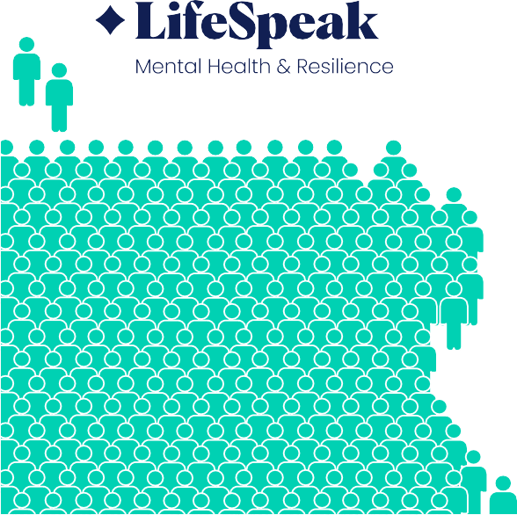
73
NPS Score
LIFESPEAK INC.
Empowering Wellbeing Through Proven Impact
4.7/5 Class Star Rating
96%
Grateful for Wellbeats
5K+ content
micro-learning
2.4M
360+ experts
2.4M
lives covered

Slide 2
LIFESPEAK INC.
Empowering Wellbeing Through Proven Impact
403,730
hours saved by Torchlight
members annually
351%
$1.01 M
dollars saved by Torchlight
members annually
ROI from Torchlight’s
Parenting & Caregiving benefits
80%
of members reduced their consumption
79%
of members reduced depressive symptoms
78%
improved their life functioning

