Slide 1
Eyesafe Partnership, Content, & Voucher
2-Slide Version

Slide 2
LifeSpeak Inc. and Eyesafe Partner to Support Eye Health
Together with Eyesafe, a global leader in blue light solutions, we are tackling the impact of screen time on eye health and overall wellbeing.
New! Eye health content Two new video series featuring Eyesafe experts to help members: Learn about eye health Debunk myths Get practical tips to protect their vision
A special offer for members* As a part of our partnership, members can enjoy a $25 voucher to use towards Eyesafe® Eyewear
*Voucher and Eyesafe products are available for U.S. members only
Notes:
We are happy to present our new partnership with Eyesafe Blue Light Glasses, a leader in blue light solutions. With screen time at an all-time high, digital eye strain, sleep disruption, and long-term vision concerns are on the rise. Our expert-backed video series break down key eye health topics, debunk myths, and share practical tips to protect your vision and reduce eye strain. Whether for yourself or your family, our content offers insights to help you see clearly—now and in the future.
As a part of our partnership. Members have access to a $25 voucher to use towards Eyesafe® Blue Light Glasses, only valid in the US.

Slide 3
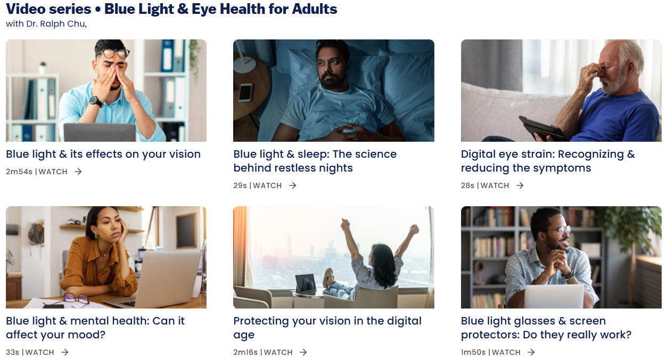
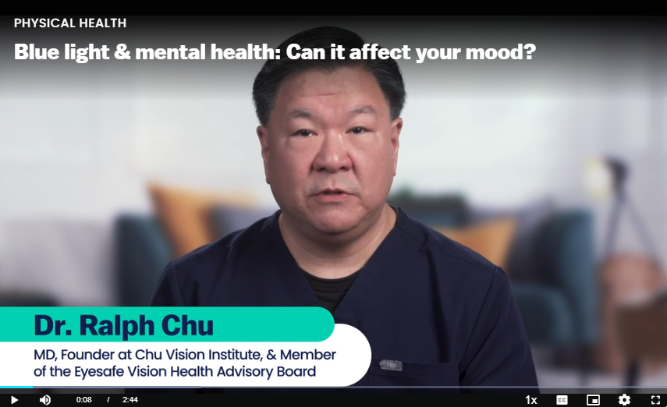
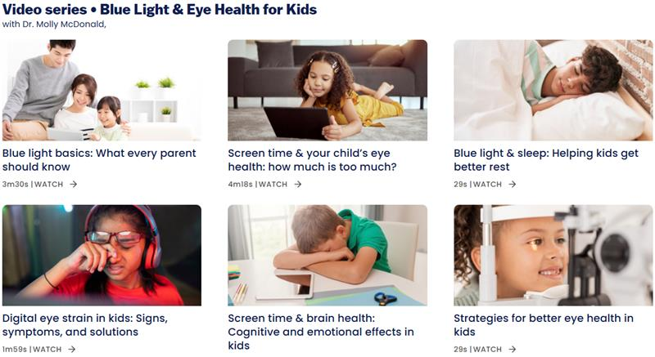
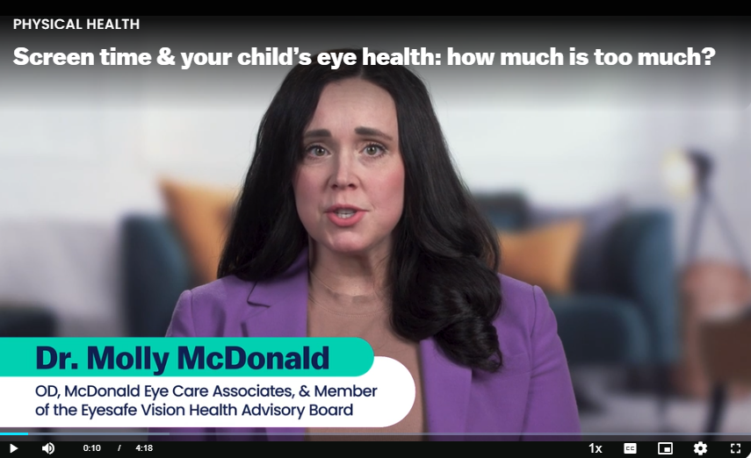
Blue Light & Eye Health for Adults:
Explore our New Eye Health Series
Learn how blue light affects your vision
Recognize and reduce symptoms of digital eye strain
Gain strategies to protect your eyes against blue light
Blue Light & Eye Health for Kids:
Learn how to protect your child’s vision, sleep, and brain health from over-exposure to screens and blue light
Set healthy screen habits
Explore strategies to protect your child's vision
Notes:
Many of us spend hours on digital devices, which can strain our eyes and affect our overall wellbeing. Our two new video series are focused on adults and children.
Blue Light & Eye Health for Adults: This video discovers how blue light affects your vision and overall health. Recognize and reduce the symptoms of digital eye strain while exploring ways to protect your eyes against blue light with glasses and screen protectors. This program is perfect for anyone who spends time on a computer, tablet or phone.
Blue Light & Eye Health for Kids: This video provides essential knowledge on how blue light affects children's vision, sleep, and brain development. Since Kids today spend more time than ever on screens, this can impact their eye health and overall wellbeing. Understanding these effects is the first step in helping children develop healthier screen habits.

Slide 4
Eyesafe Partnership, Content, & Voucher
1-Slide Version

Slide 5
New! Two eye health series featuring leading eye doctors
LifeSpeak Inc. and Eyesafe Partner to Support Eye Health
Blue Light & Eye Health for Adults
Learn eye-friendly habits to protect vision, sleep, and mental health from overexposure to screens and blue light.
Together with Eyesafe, a global leader in blue light solutions, we are tackling the impact of screen time on eye health and overall wellbeing.
Blue Light & Eye Health for Kids
Protect your child's vision and wellbeing with expert tips and healthy screen habits.
A special offer for members*
As a part of our partnership, members can enjoy a $25 voucher for Eyesafe® Blue Light Glasses.
*Voucher and Eyesafe products are available for U.S. members only
Notes:
We are happy to present our new partnership with Eyesafe Eyewear, a leader in blue light solution. With screen time at an all-time high, digital eye strain, sleep disruption, and long-term vision concerns are on the rise. Our expert-backed video series break down key eye health topics, debunk myths, and share practical tips to protect your vision and reduce eye strain. Whether for yourself or your family, our content offers insights to help you see clearly—now and in the future.
As a part of our partnership. Members have access to a $25 voucher to use towards Eyesafe® Eyewear, only valid in the US.
Many of us spend hours on digital devices, which can strain our eyes and affect our overall wellbeing. Our two new video series are focused in adults and children.
Blue Light & Eye Health for Adults: This video discovers how blue light affects your vision and overall health. Recognize and reduce the symptoms of digital eye strain while exploring ways to protect your eyes against blue light with glasses and screen protectors. This program is perfect for anyone who spends time on a computer, tablet or phone.
Blue Light & Eye Health for Kids: This video provides essential knowledge on how blue light affects children's vision, sleep, and brain development. Since Kids today spend more time than ever on screens, this can impact their eye health and overall wellbeing. Understanding these effects is the first step in helping children develop healthier screen habits.

