Slide 1
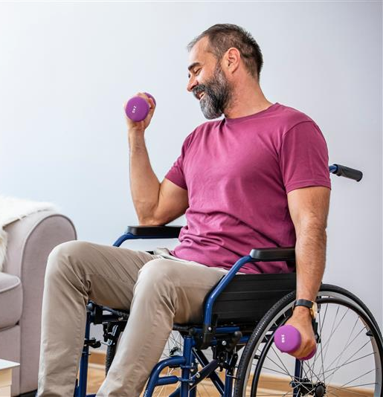
Adaptive Fitness Programs
LIMITLESS STRENGTH 8 Activities | 2 weeks
Strengthen your upper body, increase endurance, and improve overall fitness to move more energetically in everyday life.
Accessible and supportive classes designed to build strength, improve mobility and help you move through your day.
LIMITLESS MOBILITY 8 Activities | 2 weeks
Empower yourself to improve your upper body mobility as to enjoy everyday activities with greater ease.
Notes:
Welcome to the Wellbeats Wellness Adaptive Fitness Programs, where we empower you with accessible strength and mobility training to improve your movement and enhance daily living. Our classes are carefully designed to meet your unique needs, offering modifications and support every step of the way.
Through strength training, you’ll build power and endurance, while our mobility sessions improve flexibility and range of motion. Our programs give you curated classes to complete daily to keep you on track and motivated towards your health and wellness goals. Ready to get started?

