Slide 1
Turning Prevention into Savings: The ALAViDA ROI Story

Slide 2
The hidden cost of doing nothing
Substance use is quietly costing you more than you think. Most organizations underestimate the financial impact of substance use. Even light to moderate use leads to higher health costs, missed work, and lost productivity — even if members never raise their hand for help.
Absenteeism
Healthcare claims
Performance loss
The average cost per employee with an untreated SUD is $15,640.
These costs are already on your books — whether you see them or not.
Notes:
Source for the cost per employee amount: https://jamanetwork.com/journals/jamanetworkopen/fullarticle/2800719

Slide 3
Stigma-free support that translates into real-world savings
Untreated substance use drives up costs — ALAViDA changes that by helping members reduce their use before it escalates. With evidence-based care that leads to meaningful behavior change, ALAViDA delivers higher ROI and lasting value for organizations.
77%
79%
79%
of ALAViDA members see a reduction in their substance use severity
of members see a reduction in depressive symptoms
of members improve their life functioning
Supporting members through ALAViDA helps organizations save $7.59 for every $1 spent
*Based on ALAViDA’s actual engagement and outcome data
Notes:
Cost Savings per Employee
Annual Cost of Untreated Substance Use Disorders (SUDs): Employers incur an average of $15,640 per employee with an untreated SUD, primarily due to increased healthcare expenses, absenteeism, and lost productivity (https://jamanetwork.com/journals/jamanetworkopen/fullarticle/2800719)
Potential Savings with 80% Reduction: If 80% of employees reduce in a company with 2000 employees:
Employees engaging: 134
Assuming 9% have SUDs: 12 employees
Savings=12 x $15, 640 =187,680
ROI=165,840/21,840 x100=759%
Approximately 9% of full-time U.S. workers meet the criteria for a substance use disorder (SUD) each year. This statistic is based on data from the National Survey on Drug Use and Health (NSDUH) and is corroborated by organizations such as the National Safety Council
This ROI only includes those with SUDs and does not even account for prevention.

Slide 4
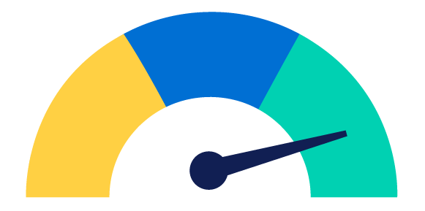
Measurable ROI from reducing alcohol consumption
Members who engage with ALAViDA reduce their alcohol consumption by an average of two drinks per day — a change that delivers measurable cost savings through lower absenteeism, fewer health claims, and improved performance.
Return on Investment
ALAViDA delivers 587% ROI: Backed by proven results
Strong
High engagement across diverse member populations
80% of engaged members reduce alcohol consumption
Savings driven by fewer health claims and lower absenteeism
Good
Exceptional
For every $1 invested in ALAViDA, organizations see $5.87 in return through alcohol-related cost savings.
*Based on ALAViDA’s actual engagement and outcome data
Notes:
ALAViDA cost and engagement
Engagement is 6.7% for book of business
For 2000 average employees at $0.91 = $21, 840 per year
6.7% engagement =134 people
If 80% of those reduce (107 people) by on average 2 units per day, that is a cost savings of $1400 (700x2) per employee.
107 x $1400 = $150,080
ROI
ROI=128,240/21,840 x100 = 587%
For every $1 spent, you get $5.87 in return.
This ROI is based on our own data on engagement, % who reduce and amount reduction.

Slide 5
Small investment. Big impact.
ALAViDA is more than a checkbox — it’s a proactive, population-wide solution that meets people early in their journey, without requiring a diagnosis or time off work.
When substance use is addressed early and effectively, the outcomes are significant, and ALAViDA proves it.
High engagement through confidential, on-demand care
Proven ROI through reduced claims and absenteeism, and improved productivity
Real behavior change through evidence-based methods and practical toolkits

